Slide 1
CSCE 580
Artificial Intelligence
Ch.3: Uninformed (Blind) Search
Fall 2011
Marco Valtorta
mgv@cse.sc.edu

Slide 2
Acknowledgment
The slides are based on the textbook [P] and other sources, including other fine textbooks
  [AIMA-2] and [AIMA-3]
  David Poole, Alan Mackworth, and Randy Goebel. Computational Intelligence: A Logical Approach. Oxford, 1998
  David Poole and Alan Mackworth. Artificial Intelligence: Foundations of Computational Agents. Cambridge, 2010 [P]
  Ivan Bratko. Prolog Programming for Artificial Intelligence, Third Edition. Addison-Wesley, 2001
  George F. Luger. Artificial Intelligence: Structures and Strategies for Complex Problem Solving, Sixth Edition. Addison-Welsey, 2009
Notes:
From: David Poole [poole@cs.ubc.ca]
Sent: Wednesday, August 06, 2008 8:47 PM
To: Valtorta, Marco
Cc: Alan Mackworth
Subject: Re: New edition of your textbook
Hi Marco,
You can point the students to
http://www.cs.ubc.ca/~poole/aibook/

Slide 3
Outline
Problem-solving agents
Problem types
Problem formulation
Example problems
Basic search algorithms

Slide 4

Problem-solving agents

Slide 5
Example: Romania
On holiday in Romania; currently in Arad.
Flight leaves tomorrow from Bucharest
Formulate goal:
  be in Bucharest
Formulate problem:
  states: various cities
  actions: drive between cities
Find solution:
  sequence of cities, e.g., Arad, Sibiu, Fagaras, Bucharest

Slide 6

Example: Romania

Slide 7
Problem types
Deterministic, fully observable → single-state problem
  Agent knows exactly which state it will be in; solution is a sequence
Non-observable → sensorless problem (conformant problem)
  Agent may have no idea where it is; solution is a sequence
Nondeterministic and/or partially observable → contingency problem
  percepts provide new information about current state
  often interleave search, execution
Unknown state space → exploration problem
Notes:
Conformant planning is defined on p.457: sensorless planning, where the planners handle uncertainty by coercing the world into known states. (Dr. O’Kane is an expert on this kind of planning.)

Slide 8

Example: Vacuum World
Single-state, start in #5. Solution?

Slide 9
Example: Vacuum World
Single-state, start in #5.
Solution? [Right, Suck]
Sensorless, start in
{1,2,3,4,5,6,7,8} e.g.,
Right goes to {2,4,6,8}
Solution?

Slide 10
Example: Vacuum World
Sensorless, start in
{1,2,3,4,5,6,7,8} e.g.,
Right goes to {2,4,6,8}
Solution?
[Right,Suck,Left,Suck]
Contingency
  Nondeterministic: Suck may
  dirty a clean carpet
  Partially observable: [location, dirt] at current location are the only percepts
  Percept: [L, Clean], i.e., start in #5 or #7
  Solution?

Slide 11
Example: Vacuum World
Sensorless, start in
{1,2,3,4,5,6,7,8} e.g.,
Right goes to {2,4,6,8}
Solution?
[Right,Suck,Left,Suck]
Contingency
  Nondeterministic: Suck may
  dirty a clean carpet
  Partially observable: [location, dirt] at current location are the only percepts
  Percept: [L, Clean], i.e., start in #5 or #7
  Solution?
  [Right, if Dirt then Suck]

Slide 12
Single-State Problem Formulation
A problem is defined by four items:
initial state e.g., "at Arad"
actions or successor function S(x) = set of action–state pairs
  e.g., S(Arad) = {<Arad → Zerind, Zerind>,
  <Arad → Timisoara, Timisoara>, … }
goal test, can be
  explicit, e.g., x = "at Bucharest"
  implicit, e.g., Checkmate(x)
path cost (additive)
  e.g., sum of distances, number of actions executed, etc.
  c(x,a,y) is the step cost, assumed to be ≥ 0
A solution is a sequence of actions leading from the initial state to a goal state
An optimal solution is a solution of lowest cost

Slide 13
Selecting a State Space
Real world is absurdly complex
  → state space must be abstracted for problem solving
(Abstract) state = set of real states
(Abstract) action = complex combination of real actions
  e.g., “Arad → Zerind” represents a complex set of possible routes, detours, rest stops, etc.
For guaranteed realizability, any real state “in Arad” must get to some real state “in Zerind”
(Abstract) solution =
  set of real paths that are solutions in the real world
Each abstract action should be “easier” than the original problem

Slide 14

Vacuum World State Space Graph
States?
Initial state?
Actions?
Goal test?
Path cost?

Slide 15
Vacuum World State Space Graph
States? integer dirt and robot location
Initial state? Any state can be the initial state
Actions? Left, Right, Suck
Goal test? no dirt at all locations
Path cost? 1 per action

Slide 16

Example: 8-puzzle
States?
Initial state?
Actions?
Goal test?
Path cost?

Slide 17
Example: 8-puzzle
States? Integer location of each tile
Initial state? Any state can be initial
Actions? {Left, Right, Up, Down}
Goal test? Check whether goal configuration is reached
Path cost? Number of actions to reach goal

Slide 18
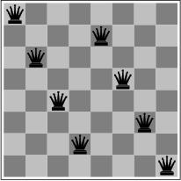
Example: 8-queens Problem
States?
Initial state?
Actions?
Goal test?
Path cost?

Slide 19
Example: 8-queens Problem
Incremental formulation vs. complete-state formulation
States?
Initial state?
Actions?
Goal test?
Path cost?

Slide 20
Example: 8-queens Problem
Incremental formulation
States? Any arrangement of 0 to 8 queens on the board
Initial state? No queens
Actions? Add queen in empty square
Goal test? 8 queens on board and none attacked
Path cost? None
3 x 10¹⁴ possible sequences to investigate

Slide 21
Example: 8-queens Problem
Incremental formulation (alternative)
States? n (0≤ n≤ 8) queens on the board, one per column in the n leftmost columns with no queen attacking another.
Actions? Add queen in leftmost empty column such that is not attacking other queens
2057 possible sequences to investigate; Yet makes no difference when n=100

Slide 22
Some Real-World Problems
Route Finding
Touring
Traveling Salesperson
VLSI Layout
  One-dimensional placement
  Cell layout
  Channel routing
Robot navigation
Automatic Assembly Sequencing
Internet searching
Various problems in bioinformatics
Notes:
All these problems have

Slide 23

Example: Robotic Assembly
States?
Initial state?
Actions?
Goal test?
Path cost?

Slide 24
Example: Robotic Assembly
States? Real-valued coordinates of robot joint angles; parts of the object to be assembled.
Initial state? Any arm position and object configuration.
Actions? Continuous motion of robot joints
Goal test? Complete assembly (without robot)
Path cost? Time to execute

Slide 25
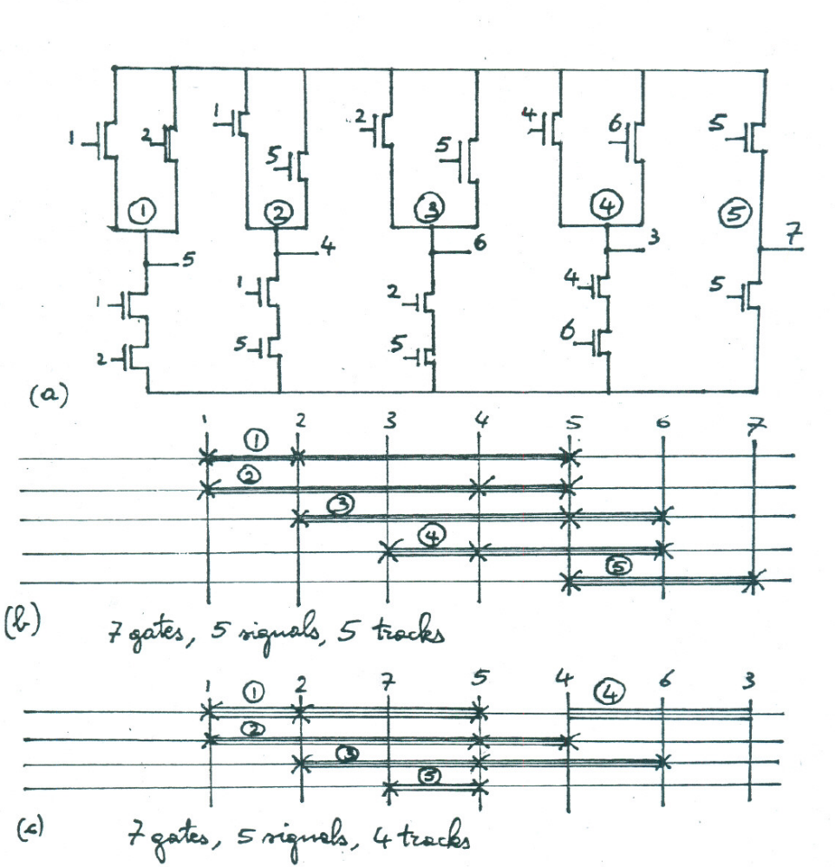
A VLSI Placement Problem
A CMOS circuit
Different layouts require different numbers of tracks
Minimizing tracks is a desirable goal
Other possible goals include minimizing total wiring length, total number of wires, length of the longest wire
Notes:
These are NAND gates. E.g, 5 = NAND(1,2); 3 = NAND(4,6)

Slide 26
Linear Placement as State-Space Search
The linear placement problem with total wiring length criterion may be formulated a state-space search problem:
I. Cederbaum. “Optimal Backboard Ordering through the Shortest Path Algorithm.” IEEE Transactions on Circuits and Systems, CAS-27, no. 5, pp. 623-632, Sept. 1974
Nets are also known as wires
  E.g., gates 1 and 4 are connected by wire 1
The state space is the power set of the set of gates, rather the space of all permutations of the gates
The result is a staged search problem
Notes:
Sangiovanni-Vincentelli and Santomauro later provided a problem-relaxation heuristic that could be used with this representation
Let there be N gates, g1, g2, ….gN. The state space of the linear placement problem is the power set of N. Arcs connect sets to supersets having exactly one more element, i.e. each operator (action) adds a gate to the set of gates to which it is applied. An arc is labeled by the number of nets (i.e. wires) leaving the gates at the endpoint of the arc. For example, there are two wires (namely, 1 and 2) leaving gate 1; there are two wires (namely, 1 and 3) leaving the two gates 1 and 2 (note that wire 2 is between gates 1 and 2, so it does not leave them); there is one wire (namely, 1) leaving gate 4.

Slide 27

Tree Search Algorithms
Basic idea:
  offline, simulated exploration of state space by generating successors of already-explored states (a.k.a. expanding states)

Slide 28

Tree Search Example

Slide 29

Tree Search Example

Slide 30

Tree Search Example

Slide 31

Implementation: General Tree Search

Slide 32

Implementation: States vs. Nodes
A state is a (representation of) a physical configuration
A node is a data structure constituting part of a search tree includes state, parent node, action, path cost g(x), depth
The Expand function creates new nodes, filling in the various fields and using the SuccessorFn of the problem to create the corresponding states

Slide 33
Search Strategies
A search strategy is defined by picking the order of node expansion
Strategies are evaluated along the following dimensions:
  completeness: does it always find a solution if one exists?
  time complexity: number of nodes generated (or: expanded)
  space complexity: maximum number of nodes in memory
  optimality: does it always find a least-cost solution?
Time and space complexity are measured in terms of
  b: maximum branching factor of the search tree
  d: depth of the least-cost solution
  m: maximum depth of the state space (may be ∞)

Slide 34
Uninformed Search Strategies
Uninformed (a.k.a. blind) search strategies use only the information available in the problem definition
Breadth-first search
Uniform-cost search
Depth-first search
Depth-limited search
Iterative deepening search

Slide 35

Breadth-first Search
Expand shallowest unexpanded node
Implementation:
  fringe is a FIFO queue, i.e., new successors go at end

Slide 36

Breadth-first Search
Expand shallowest unexpanded node
Implementation:
  fringe is a FIFO queue, i.e., new successors go at end

Slide 37

Breadth-first Search
Expand shallowest unexpanded node
Implementation:
  fringe is a FIFO queue, i.e., new successors go at end

Slide 38

Breadth-first Search
Expand shallowest unexpanded node
Implementation:
  fringe is a FIFO queue, i.e., new successors go at end

Slide 39
Properties of Breadth-first Search
Complete? Yes (if b is finite)
Time? 1+b+b²+b³+… +b^{d} + b(b^{d}-1) = O(b^{d+1})
Space? O(b^{d+1}) (keeps every node in memory)
Optimal? Yes (if cost = 1 per step)
Space is the bigger problem (more than time)

Slide 40
Uniform-cost Search (Dijkstra’s Algorithm; Lowest-cost First)
Expand least-cost unexpanded node
Implementation:
  fringe = (priority) queue ordered by path cost
Equivalent to breadth-first if step costs all equal
Complete? Yes, if step cost ≥ ε
Time? # of nodes with g ≤ cost of optimal solution, O(b^{ceiling(C*/ ε)}) where C* is the cost of the optimal solution
Space? # of nodes with g ≤ cost of optimal solution, O(b^{ceiling(C*/ ε)})
Optimal? Yes – nodes expanded in increasing order of g(n)

Slide 41

Depth-first Search
Expand deepest unexpanded node
Implementation:
  fringe = LIFO queue, i.e., put successors at front

Slide 42

Depth-first Search
Expand deepest unexpanded node
Implementation:
  fringe = LIFO queue, i.e., put successors at front

Slide 43

Depth-first Search
Expand deepest unexpanded node
Implementation:
  fringe = LIFO queue, i.e., put successors at front

Slide 44

Depth-first Search
Expand deepest unexpanded node
Implementation:
  fringe = LIFO queue, i.e., put successors at front

Slide 45

Depth-first Search
Expand deepest unexpanded node
Implementation:
  fringe = LIFO queue, i.e., put successors at front

Slide 46

Depth-first Search
Expand deepest unexpanded node
Implementation:
  fringe = LIFO queue, i.e., put successors at front

Slide 47

Depth-first Search
Expand deepest unexpanded node
Implementation:
  fringe = LIFO queue, i.e., put successors at front

Slide 48

Depth-first Search
Expand deepest unexpanded node
Implementation:
  fringe = LIFO queue, i.e., put successors at front

Slide 49

Depth-first Search
Expand deepest unexpanded node
Implementation:
  fringe = LIFO queue, i.e., put successors at front

Slide 50

Depth-first Search
Expand deepest unexpanded node
Implementation:
  fringe = LIFO queue, i.e., put successors at front

Slide 51

Depth-first Search
Expand deepest unexpanded node
Implementation:
  fringe = LIFO queue, i.e., put successors at front

Slide 52

Depth-first Search
Expand deepest unexpanded node
Implementation:
  fringe = LIFO queue, i.e., put successors at front

Slide 53
Properties of Depth-first Search
Complete? No: fails in infinite-depth spaces, spaces with loops
  Modify to avoid repeated states along path
    → complete in finite spaces
Time? O(b^{m}): terrible if m is much larger than d
  but if solutions are dense, may be much faster than breadth-first
Space? O(bm), i.e., linear space!
Optimal? No
Variant: backtracking search only keeps one successor at a time and remembers what successor needs to be generated next. Space complexity is reduced to O(b)

Slide 54

Depth-limited Search
= depth-first search with depth limit l,
i.e., nodes at depth l have no successors
Recursive implementation:

Slide 55

Iterative Deepening Search

Slide 56

Iterative Deepening Search l =0

Slide 57

Iterative Deepening Search l =1

Slide 58

Iterative Deepening Search l =2

Slide 59

Iterative Deepening Search l =3

Slide 60
Iterative Deepening Search
Number of nodes generated in a depth-limited search to depth d with branching factor b:
N_{DLS} = b⁰ + b¹ + b² + … + b^{d-2} + b^{d-1} + b^{d}
Number of nodes generated in an iterative deepening search to depth d with branching factor b:
N_{IDS} = (d+1)b⁰ + d b¹ + (d-1)b² + … + 3b^{d-2} +2b^{d-1} + 1b^{d}
For b = 10, d = 5,
  N_{DLS} = 1 + 10 + 100 + 1,000 + 10,000 + 100,000 = 111,111
  N_{IDS} = 6 + 50 + 400 + 3,000 + 20,000 + 100,000 = 123,456
Overhead = (123,456 - 111,111)/111,111 = 11%

Slide 61
Properties of Iterative Deepening Search
Complete? Yes
Time? (d+1)b⁰ + d b¹ + (d-1)b² + … + b^{d} = O(b^{d})
Space? O(bd)
Optimal? Yes, if step cost = 1

Slide 62
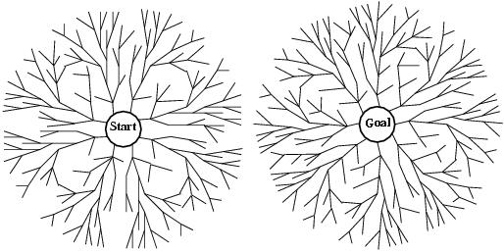
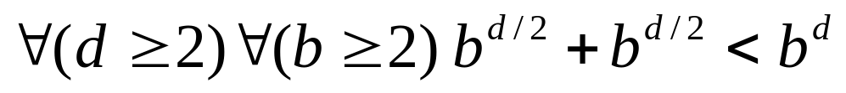
Bidirectional Search
Two simultaneous searches from start and goal
  Motivation:
The inequality holds even for smaller values of b, when d is sufficiently large
Check whether the node belongs to the other fringe before expansion
Space complexity is the most significant weakness.
Complete and optimal if both searches are BF
Stopping condition is difficult

Slide 63
How to Search Backwards?
The predecessor of each node should be efficiently computable
  When actions (as represented) are easily reversible.

Slide 64

Summary of Algorithms

Slide 65

Repeated States
Failure to detect repeated states can turn a linear problem into an exponential one

Slide 66

Graph Search
Closed list stores all expanded nodes

Slide 67
Graph Search: Evaluation
Optimality:
  GRAPH-SEARCH discard newly discovered paths
    This may result in a sub-optimal solution
    Still optimal when uniform-cost search or BF-search with constant step cost
Time and space complexity:
  proportional to the size of the state space
    (may be much smaller than O(b^{d}))
  DF- and ID-search with closed list no longer has linear space requirements since all nodes are stored in closed list

Slide 68
Uniform-Cost (Dijkstra) for Graphs
1. Put the start node s in OPEN. Set g(s) to 0
2. If OPEN is empty, exit with failure
3. Remove from OPEN and place in CLOSED a node n for which g(n) is minimum
4. If n is a goal node, exit with the solution obtained by tracing back pointers from n to s
5. Expand n, generating all of its successors. For each successor n' of n:
  a. compute g'(n')=g(n)+c(n,n')
  b. if n' is already on OPEN, and g'(n')<g(n'), let g(n')=g'(n’) and redirect the pointer from n' to n
  c. if n' is neither on OPEN or on CLOSED, let g(n')=g'(n'), attach a pointer from n' to n, and place n' on OPEN
6. Go to 2
Notes:
Original Reference
Dijkstra, E. W. "A Note on Two Problems in Connexion With Graphs."
Numerische Matematik,
1 (1959), 269-271.
Some properties of Dijkstra's algorithm
1. When node n is closed at step 3, g(n) is at least as high as the g value
of all already closed nodes and all nodes with lower g values than
g(n) have already been closed.
2. When node n is closed in step 3, g(n)=f*(n).
3. Only nodes for which g(n)<f*(k) are expanded in step 5 (if there is a
path from the start node to the goal node.)
4. Dijkstra's algorithm never expands the same node twice.

Slide 69
Bidirectional Uniform-Cost Algorithm
(Assume that there is only one goal node, k.)
1. Put the start node s in OPEN1 and the goal node k in OPEN2. Set g(s) and h(k) to 0
2'. If OPEN1 is empty, exit with failure
3'. Remove from OPEN1 and place in CLOSED1 a node n for which g(n) is minimum
4'. If n is in CLOSED2, exit with the solution obtained by tracing backpointers from n to s and forward pointers from n to k
5'. Expand n, generating all of its successors. For each successor n' of n:
  a. compute g'(n')=g(n)+c(n,n')
  b. if n' is already on OPEN1, and g'(n')<g(n'), let g(n')=g'(n) and redirect the pointer from n' to n
  c. if n' is neither on OPEN1 or on CLOSED1, let g(n')=g'(n'), attach a pointer from n' to n, and place n' on OPEN1
2". If OPEN2 is empty, exit with failure
3". Remove from OPEN2 and place in CLOSED2 a node n for which h(n) is minimum
4". If n is in CLOSED1, exit with the solution obtained by tracing forwards pointers from n to k and backpointers from s to n
5". Expand n, generating all of its predecessors. For each predecessor n' of n:
  a. compute h'(n')=h(n)+c(n',n)
  b. if n' is already on OPEN2, and h'(n')<h(n'), let h(n')=h'(n) and redirect the pointer from n' to n
  c. if n' is neither on OPEN2 or on CLOSED2, let n(n')=n'(n'), attach a pointer from n' to n, and place n' on OPEN2
6. Go to 2'.

Slide 70
Summary
Problem formulation usually requires abstracting away real-world details to define a state space that can feasibly be explored
Variety of uninformed search strategies
Iterative deepening search uses only linear space and not much more time than other uninformed algorithms
  It is the preferred blind search method for trees when there is a large search space, the length of the solution is unknown, and the cost of each action is the same

Slide 71
Search with Partial Information
Previous assumption:
  Environment is fully observable
  Environment is deterministic
  Agent knows the effects of its actions
What if knowledge of states or actions is incomplete?

Slide 72
Search with Partial Information
Partial knowledge of states and actions:
sensorless or conformant problem
  Agent may have no idea where it is
contingency problem
  Percepts provide new information about current state; solution is a tree or policy; often interleave search and execution
  If uncertainty is caused by actions of another agent: adversarial problem
exploration problem
  When states and actions of the environment are unknown

Slide 73
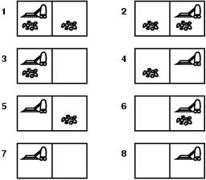
Sensorless Vacuum World
Search space of belief states
Solution = belief state with all members goal states.
If S states then 2^{S} belief states.
Murphy’s law:
  Suck can dirty a clear square.

Slide 74
Sensorless Vacuum World
start in {1,2,3,4,5,6,7,8} e.g Right goes to {2,4,6,8}. Solution?
  [Right, Suck, Left,Suck]
When the world is not fully observable: reason about a set of states that might be reached
  =belief state

Slide 75
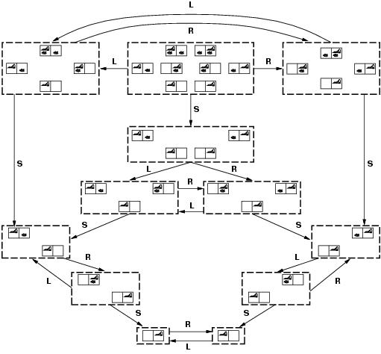
Belief States of Vacuum World
Notes:
Figure 3.21 [AIMA] Initial State is top middle

Slide 76
Contingency Problems
Contingency, start in {1,3}.
Murphy’s law, Suck can dirty a clean carpet.
Local sensing: dirt, location only.
  Percept = [L,Dirty] ={1,3}
  [Suck] = {5,7}
  [Right] ={6,8}
  [Suck] in {6}={8} (Success)
  BUT [Suck] in {8} = failure
Solution?
  Belief-state: no fixed action sequence guarantees solution
Relax requirement:
  [Suck, Right, if [R,dirty] then Suck]
  Select actions based on contingencies arising during execution.

